Slide 1
Parts and Function of a Microscope

Slide 2
When we think about science, we often imagine microscopes.
Microscopes are an important tool used in many fields of science to look at the very small.
The most common microscope we use is the compound light microscope.

Slide 3

In this Smart Lesson we will be going over the following:
1. | Name the parts of the microscope.
2. | State the function of the parts of the microscope.

Slide 4
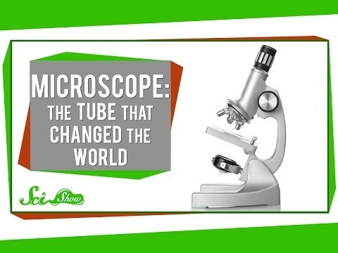

Slide 5


Slide 6
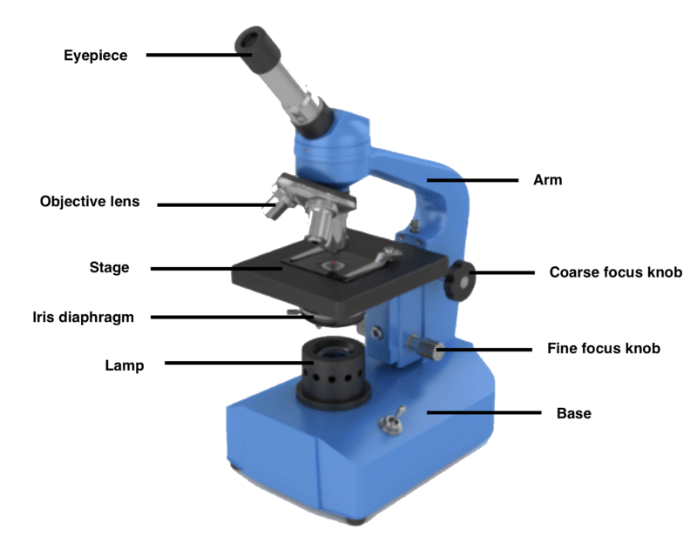
Below is an image of a microscope with its main parts labelled.

Slide 7
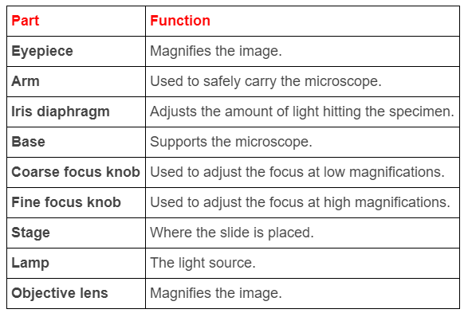
The table below outlines the function of each part of a microscope.

